Slide 1


Exam revision-the role of the parent/carer.

Slide 2



Slide 3



This is a stressful time for everyone-

Slide 4

We’re all on the same side-

Slide 5

How can parents/carers help?
1. Know the journey.
W/c November 8th- Year 11 APA1 Data Release.
November 11th- Year 11 Parent’s Evening-4pm-7pm.
November 19th- Y11 Drop Down Day- Health & Wellbeing.
November 22nd-Dec 15th- Mock Exams.
January 21st, 2022- Mock Results Day (parent’s welcome)
W/c January 24th- Mock Interviews.
February 2022- College Application Deadlines.
February/March 2022- College Interviews.

Slide 6





How can parents/carers help?
2. Raise Aspirations.
Saturday 16th October 9.30am - 12.30pm
Thursday 4th November 5.30pm - 8.30pm
Tuesday 30th November 5.30pm - 8.30pm
Thursday 21st October 5.30pm - 8.30pm
Saturday 13th November 10am - 1.00pm
Wednesday 1st December 5.30pm - 8.30pm
Saturday 6th November
Saturday 22nd January
Wednesday 16th March
Wednesday 20th October 4.30pm - 7.30pm

Slide 7
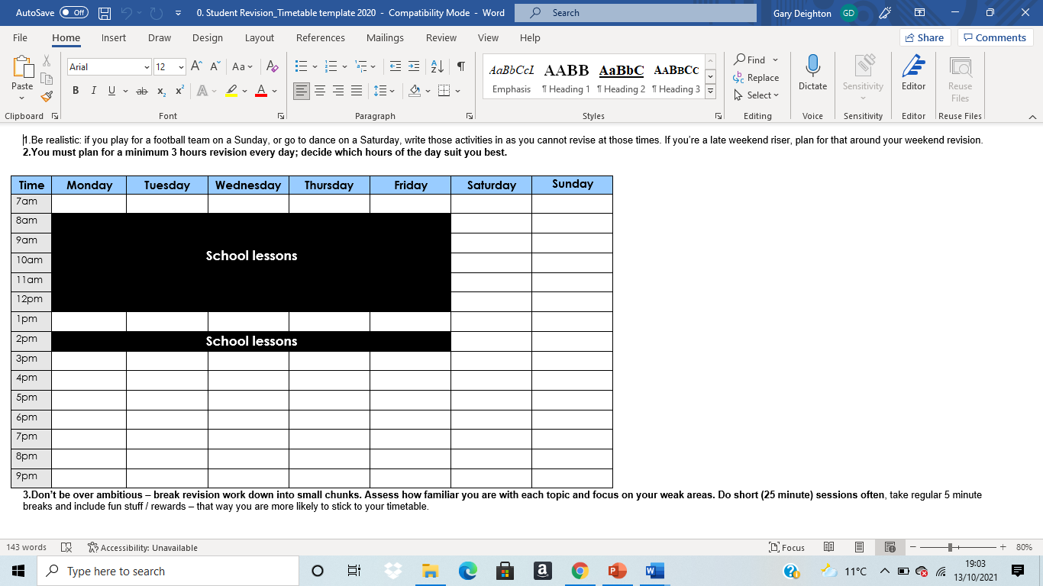
How can parents/carers help?
3. Revision timetable.
Extra classes in school COUNT!
Have you factored in social/sports activities?
Is the revision balanced across all subjects? Is the revision topics they NEED to focus on?
Is revision topic-focused?
Help your child plan so it’s achievable.
R&J
Fractions
History
History
History
History
History
History
History
History
History
History
History
History
History
History

Slide 8
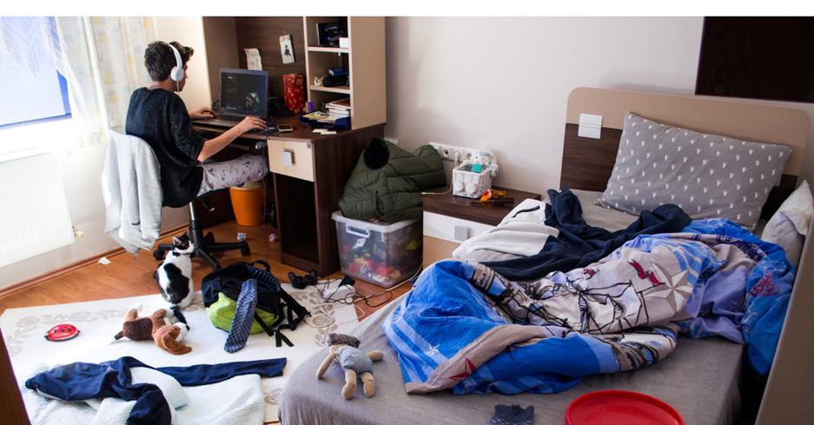



How can parents/carers help?
4. Learning environment/Good practice.
Tidy, organised working area.
Doesn’t have to be bedroom. Kitchen table can be just fine.
Quiet space for concentration.
Time the activities and test them.
Have they got revision materials?

Slide 9


How can parents/carers help?
5. Wellbeing.

Slide 10

gdeighton@nhtschool.co.uk jgeorge@nhtschool.co.uk

