Slide 1
Revision Strategies
Do what works

Slide 2


Slide 3
WHAT WE WILL COVER THIS EVENING . . .
What is unique about the teenage brain?
What does research says about the best ways to learn?
Three simple ways to make the most of supporting your child with revision.

Slide 4
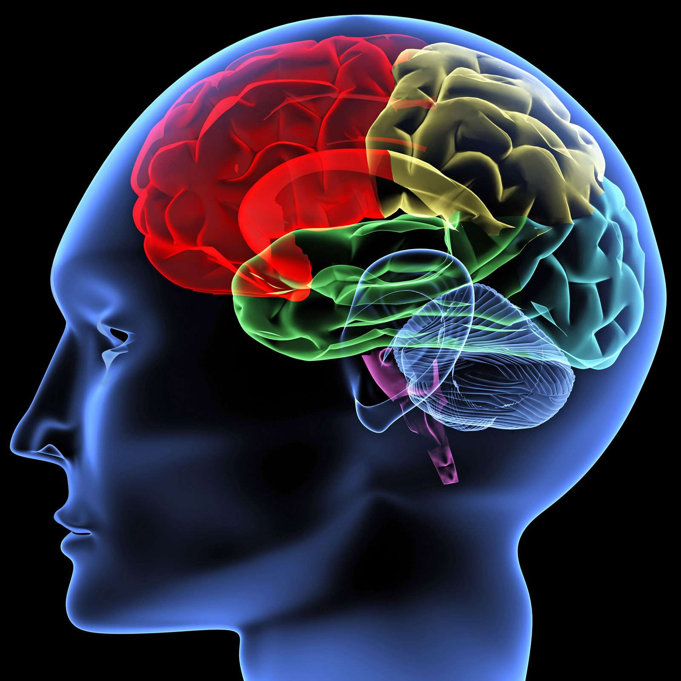
What is unique about the teenage brain?

Slide 5
CAN YOU REMEMBER BEING A TEEN?
The logical part of the brain (the frontal cortex) is underdeveloped so you might find that your teen reacts in ways that you don’t understand!
Good news! The teen brain is ready to learn and adapt – plasticity!
More good news. Whilst the teen brain can be vulnerable because it is still developing, it is also incredibly resilient.
Basically, with the right techniques, you can grow and develop your brain especially during the teenage years.

Slide 6
What does research says about the best ways to learn?

Slide 7

THERE ARE LOTS OF HINTS AND TIPS OUT THERE ABOUT REVISION . . .
Cognitive Overload Theory
Transferring information from short term memory to long term memory.

Slide 8

Three simple ways to make the most of supporting your child with revision.

Slide 9
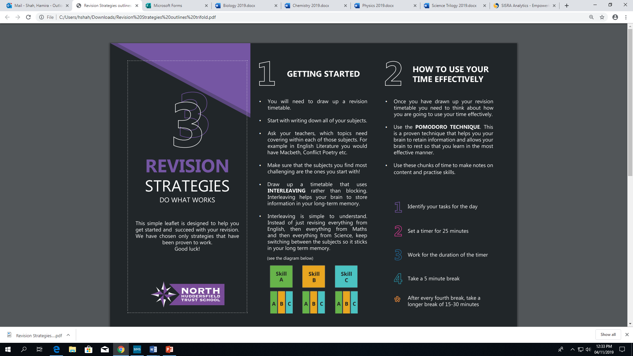
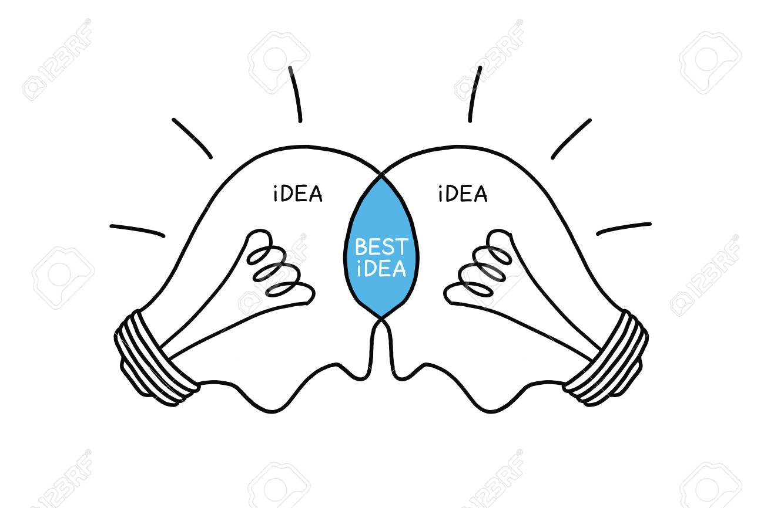

Slide 10
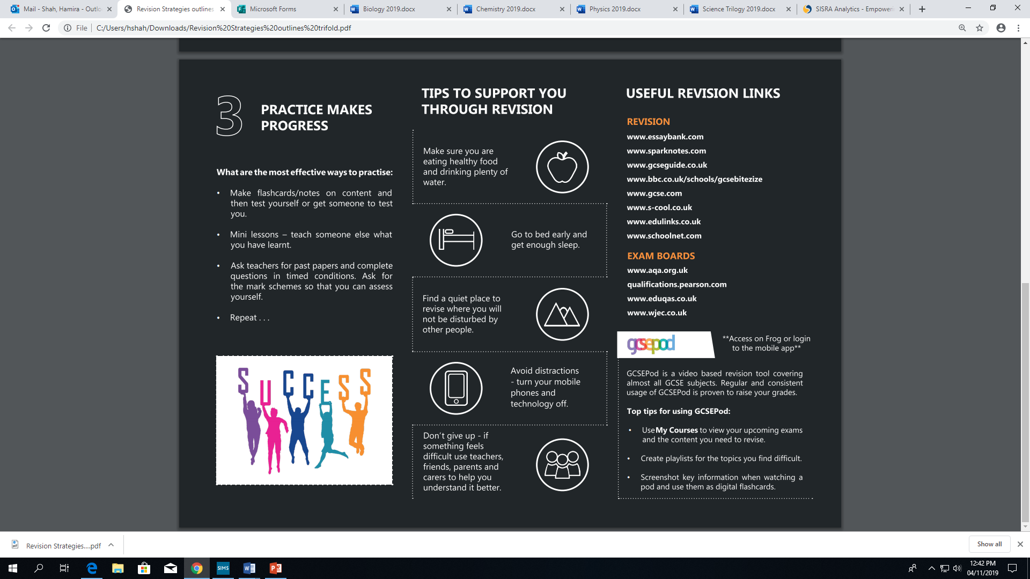

Slide 11

This leaflet is split into three easy sections.

Slide 12


Getting started

Slide 13
Time | Monday | Tuesday | Wednesday | Thursday | Friday | Saturday | Sunday
7am
8am | School lessons
9am
10am
11am
12pm
1pm
2pm | School lessons
3pm
4pm
5pm
6pm
7pm
8pm
9pm
English Language
English Literature
Maths
Combined Science
Option 1
Option 2
Option 3
English Literature
Romeo and Juliet
An Inspector Calls
Christmas Carol
Poetry
XX

Slide 14
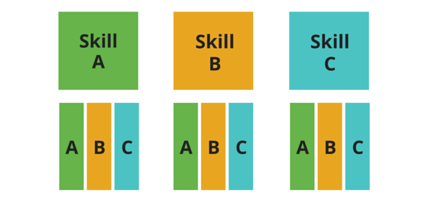
Time | Monday | Tuesday | Wednesday | Thursday | Friday | Saturday | Sunday
7am
8am | School lessons
9am
10am |  |  |  |  |  | Christmas Carol - chapters | Maths – finish Trigonometry
11am
12pm
1pm
2pm |  |  |  |  |  | Maths - Trigonometry | History – Germany Part 2
3pm
4pm
5pm |  |  |  |  |  | History – Germany | Christmas Carol – key quotes
6pm
7pm
8pm
9pm
Draw up a timetable that uses INTERLEAVING rather than blocking. INTERLEAVING helps your brain to store information in your long-term memory.

Slide 15
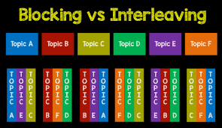

Slide 16


How to use your time effectively

Slide 17
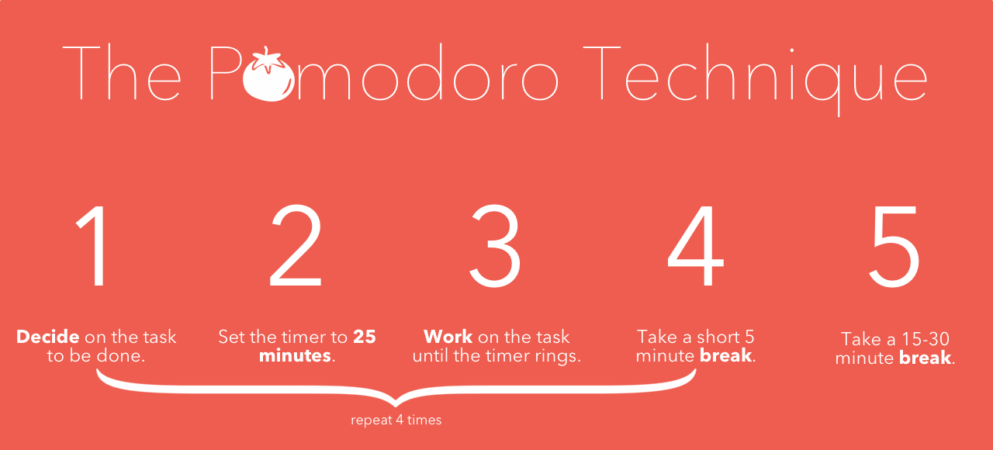

Slide 18
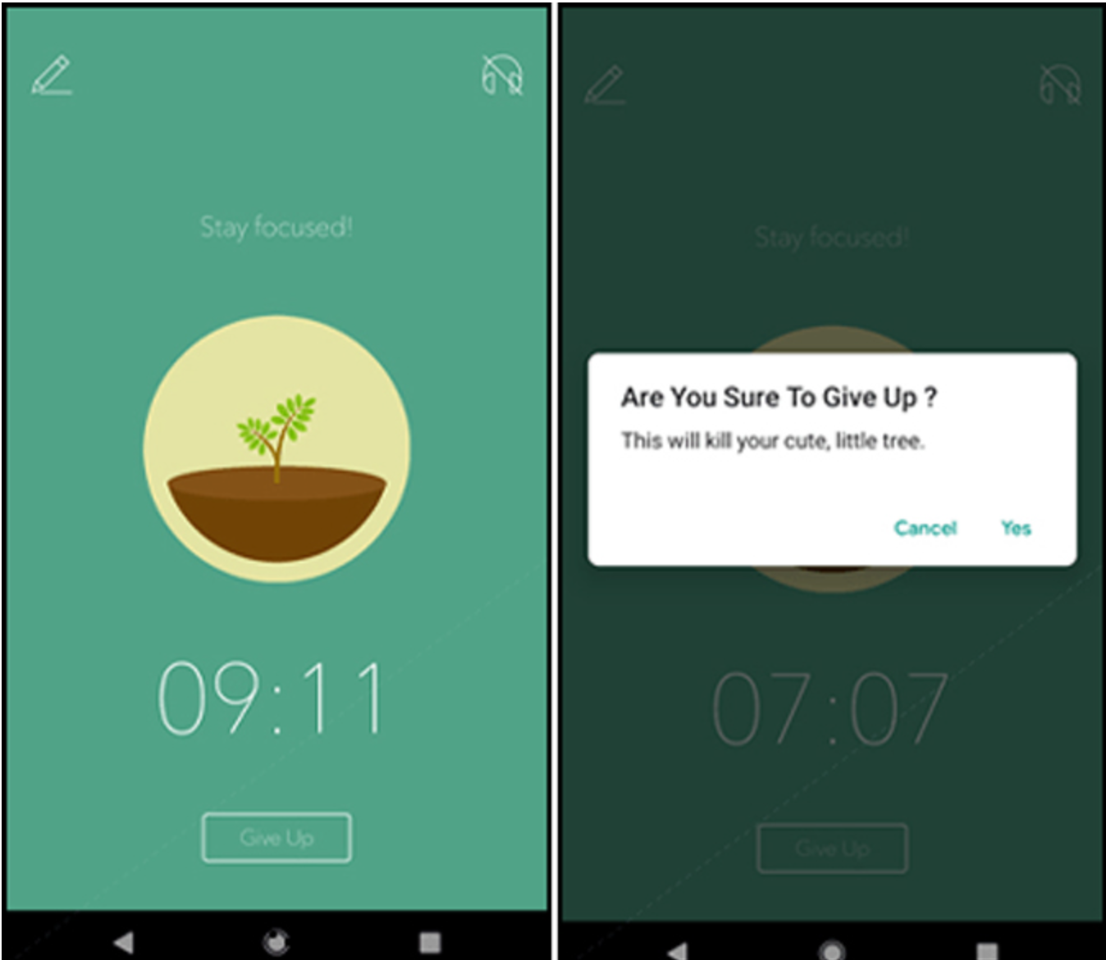
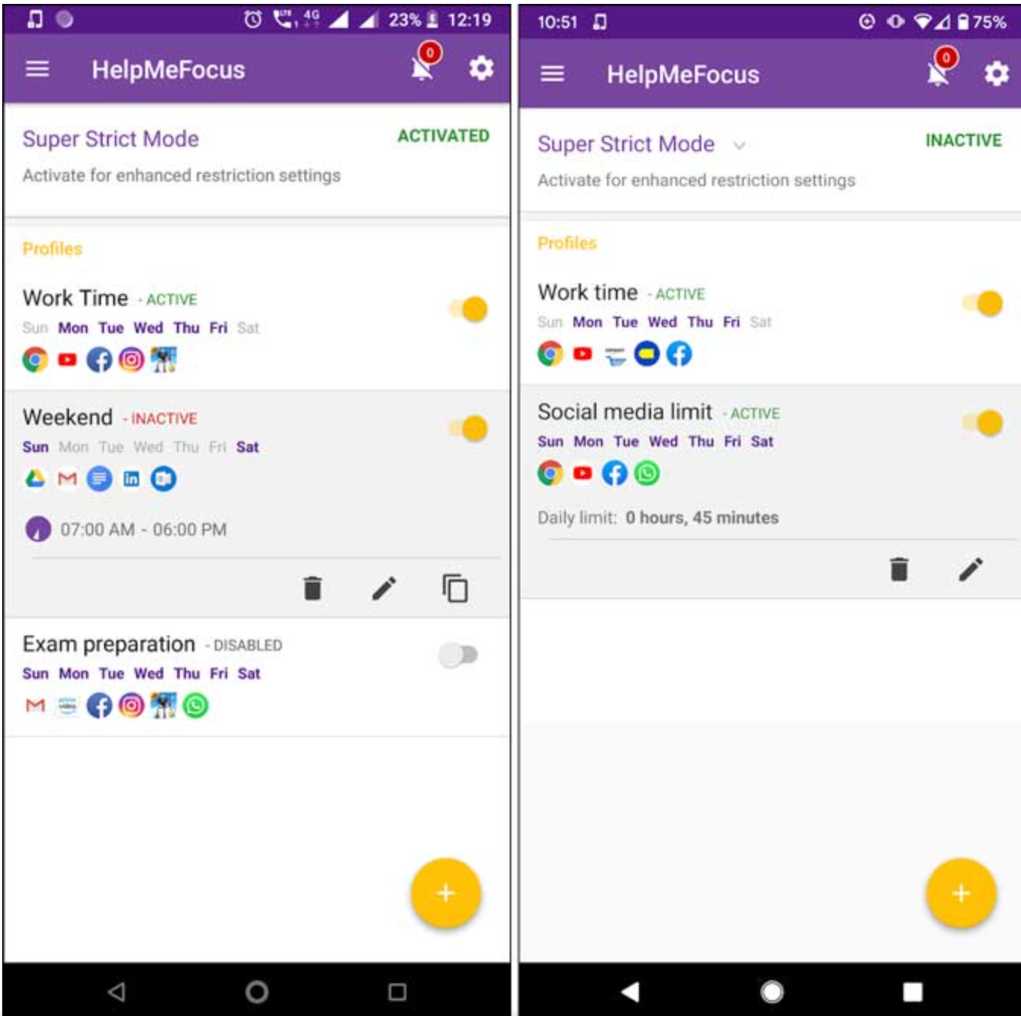
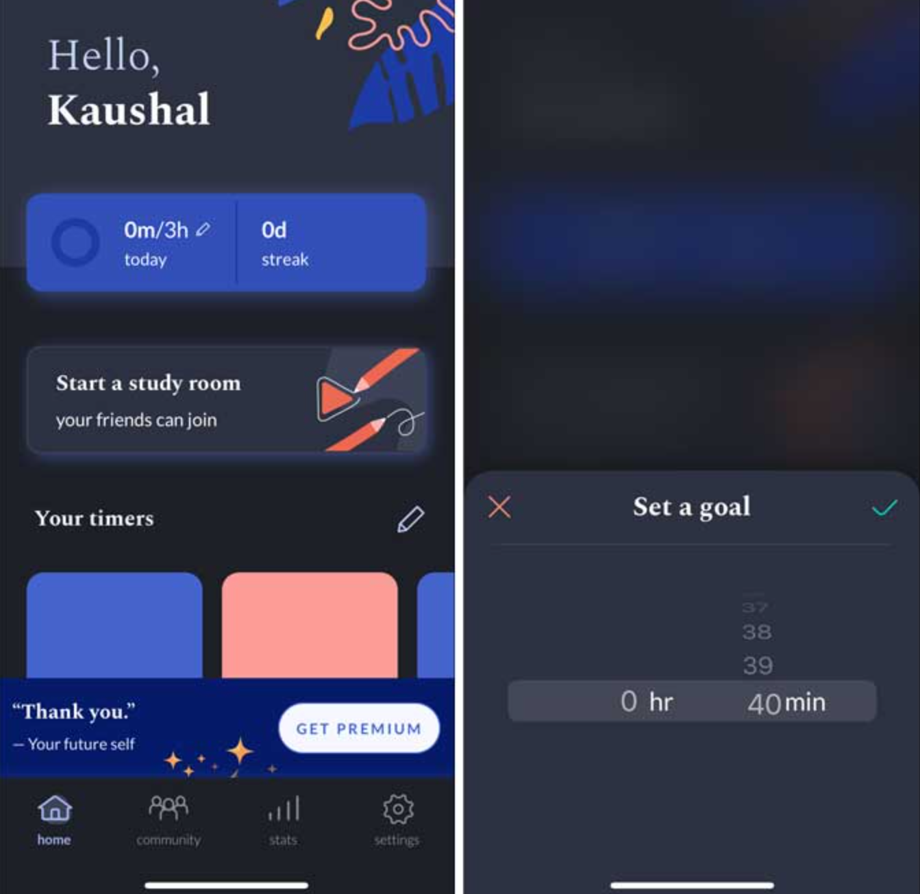
Apps that can help your child to focus and stick to the Pomodoro technique
Help Me Focus – blocks apps
Forest
Flipd – can be done in groups

Slide 19

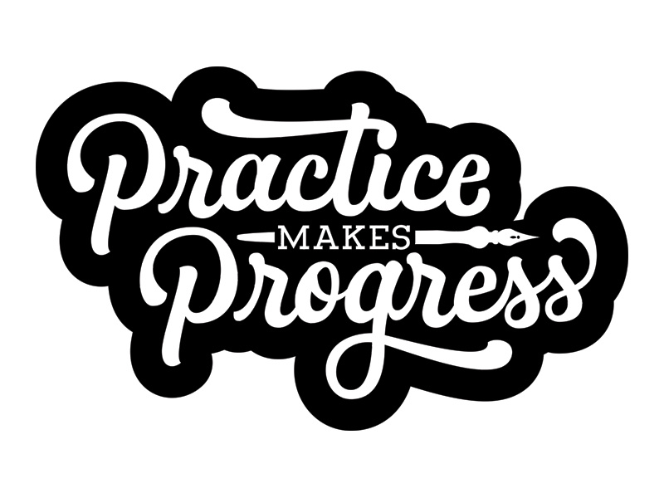
Practice makes progress

Slide 20
Practice makes progress
What are the most effective ways to practise:
  Make flashcards/notes on content and then test yourself or get someone to test you.
  Mini lessons – teach someone else what you have learnt.
  Ask teachers for past papers and complete questions in timed conditions. Ask for the mark schemes so that you can assess yourself.
  Repeat . . .

Slide 21


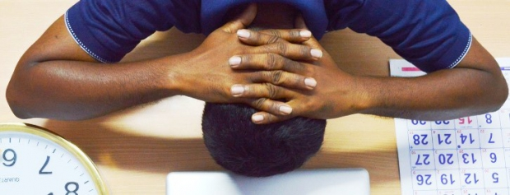
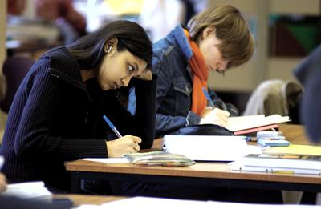

Hopefully, we won’t get this!

Slide 22
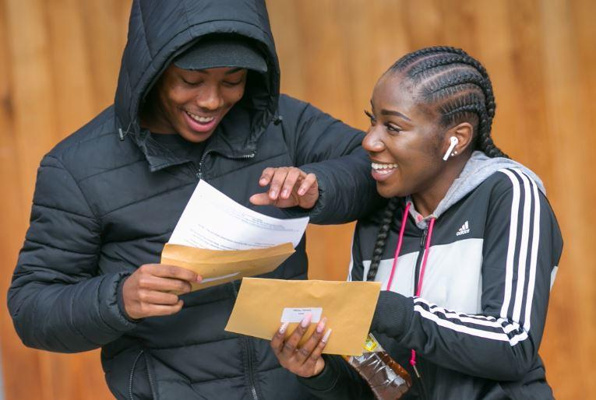
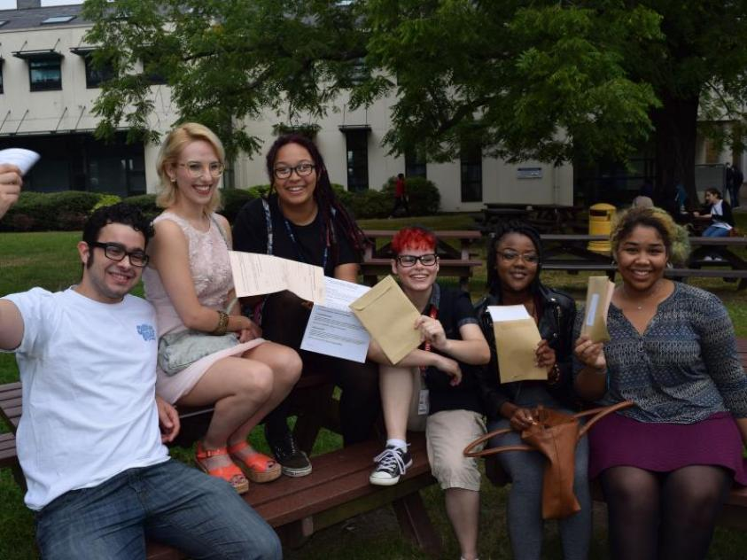
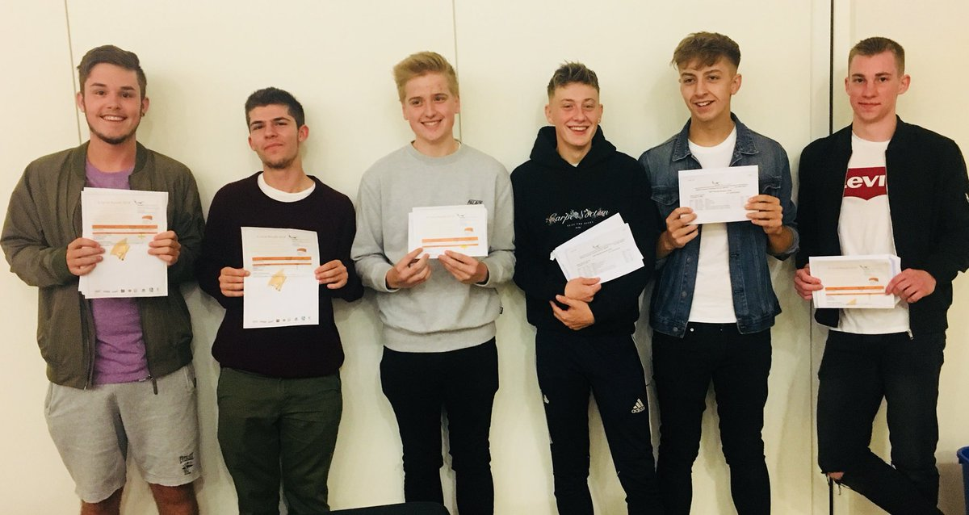
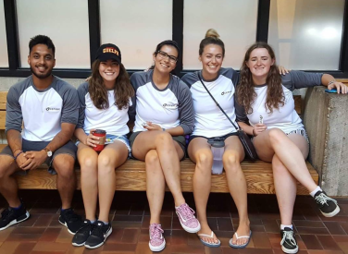
But we do want to get to this . . . It’s what you deserve!

Slide 23



